Slide 1
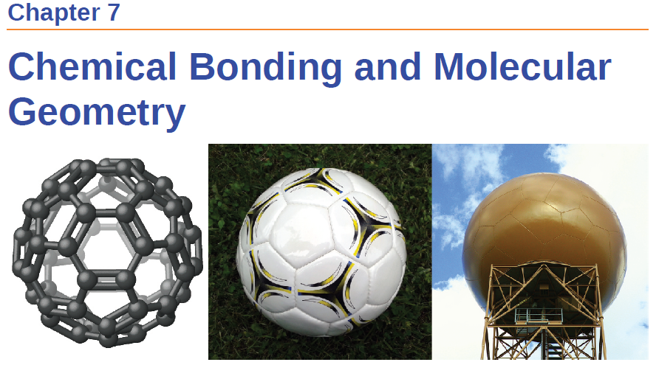
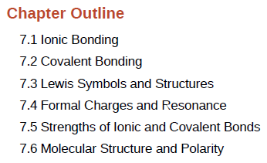

Slide 2
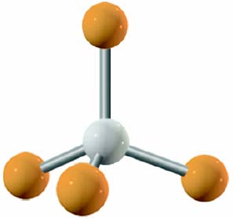
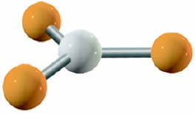

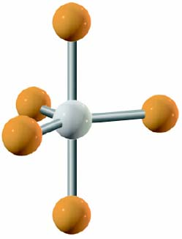
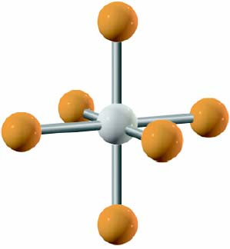
Five Basic Molecular Structures
Linear
Trigonal
Tetrahedral
Trigonal bipyramidal
Octahedral
Most atom-atom interactions have these basic shapes!
But first a little history…

Slide 3
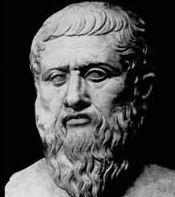
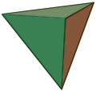
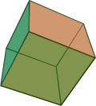
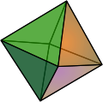
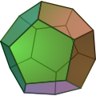

“Elemental” Geometries
Plato
Each of the five classical elements (ether, earth, air, fire, and water) has a shape.
circa 428 ─ 348 B.C.
Greek Philosopher
Tetrahedron
Hexahedron
Octahedron
Dodecahedron
Icosahedron

Slide 4
“Elemental” Geometries
Tetrahedron
Hexahedron
Octahedron
Dodecahedron
Icosahedron
Euclidean Geometry:
A Platonic solid is a regular, convex polyhedron with congruent faces of regular polygons and the same number of faces meeting at each vertex. Five solids meet those criteria, and each is named after its number of faces.
https://en.wikipedia.org/wiki/Platonic_solid
Notes:
What is platonic solid
1. All the solid angles are equivalent.
3. All the vertices are surrounded by the same number of faces.

Slide 5
“Elemental” Geometries
Tetrahedron
Hexahedron
Octahedron
Dodecahedron
Icosahedron
The building blocks of the universe according to Plato:
Earth, Water, Fire, Air, Ether.
https://en.wikipedia.org/wiki/Platonic_solid

Slide 6
“Elemental” Geometries
Tetrahedron
Hexahedron
Octahedron
Dodecahedron
Icosahedron
A
B
C
D
E
Fire
What is the shape of Fire?
https://en.wikipedia.org/wiki/Platonic_solid

Slide 7
“Elemental” Geometries
Tetrahedron
Hexahedron
Octahedron
Dodecahedron
Icosahedron
A
B
C
D
E
Fire
Water
What is the shape of Water?
https://en.wikipedia.org/wiki/Platonic_solid

Slide 8
“Elemental” Geometries
Tetrahedron
Hexahedron
Octahedron
Dodecahedron
Icosahedron
A
B
C
D
E
Fire
Earth
Water
What is the shape of Earth?
https://en.wikipedia.org/wiki/Platonic_solid

Slide 9
“Elemental” Geometries
Tetrahedron
Hexahedron
Octahedron
Dodecahedron
Icosahedron
A
B
C
D
E
Fire
Earth
Air
Water
What is the shape of Air?
https://en.wikipedia.org/wiki/Platonic_solid

Slide 10
“Elemental” Geometries
Tetrahedron
Hexahedron
Octahedron
Dodecahedron
Icosahedron
A
B
C
D
E
Fire
Earth
Air
Ether
Water
Ether- “The dodecahedron has 12 faces, and our number symbolism associates 12 with the zodiac, and this might be Plato's meaning when he wrote of "embroidering the constellations" on the dodecahedron”.
https://en.wikipedia.org/wiki/Platonic_solid

Slide 11
“Elemental” Geometries
Tetrahedron
Hexahedron
Octahedron
Dodecahedron
Icosahedron
Fire
Earth
Air
Ether
Water
The building blocks of the universe according to Plato.
https://en.wikipedia.org/wiki/Platonic_solid

Slide 12
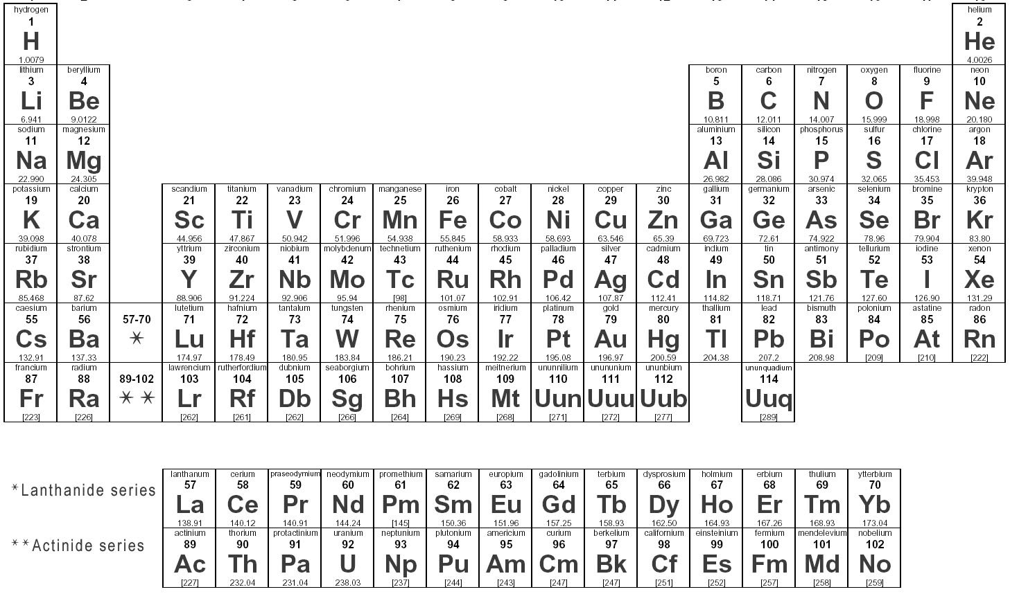
What Plato didn't know!
Atoms combine via chemical bond to make molecules
Molecules have shapes
Molecular shapes dictate their properties
Also he did not test his hypothesis.

Slide 13
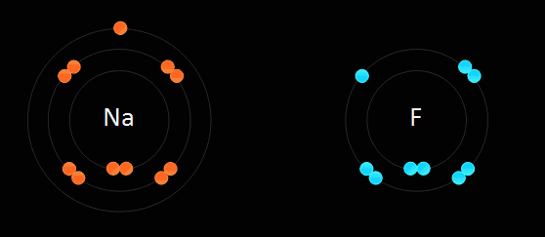
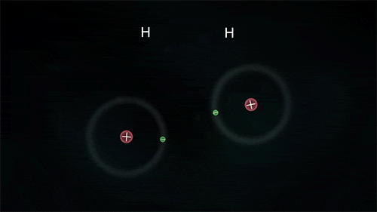
Chemical Bonds
Attractive forces that hold atoms together in compounds are called chemical bonds.
There are two main types of chemical bonds:
  Ionic bonds – resulting from electrostatic attraction between cations and anions
  Covalent bonds – resulting from sharing of one or more electron pairs between two atoms

Slide 14
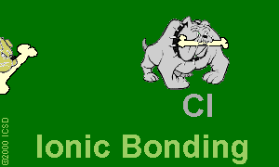

Chemical Bonds
Attractive forces that hold atoms together in compounds are called chemical bonds.
There are two main types of chemical bonds:
  Ionic bonds – resulting from electrostatic attraction between cations and anions
  Covalent bonds – resulting from sharing of one or more electron pairs between two atoms

Slide 15
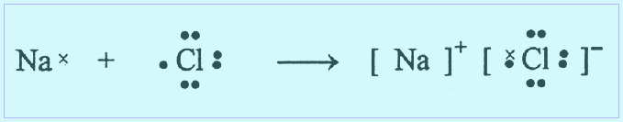
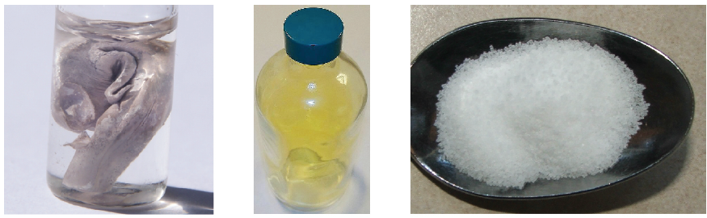
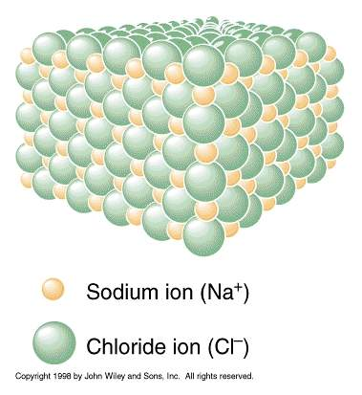
Ionic Bonds
Between atoms with very different electronegativities
Transfer of electrons produce charged ions
Typically crystalline structures (rigid and brittle)
Examples; NaCl, CaCl₂, K₂O
+
=

Slide 16
Covalent bond
Between atoms of similar electronegativities
Sharing a pair of electrons
In most compounds, the representative elements achieve noble gas configurations
Electrons which are shared among two atoms are called bonding electrons
Unshared electrons are called
lone pairs or nonbonding electrons

Slide 17


Slide 18
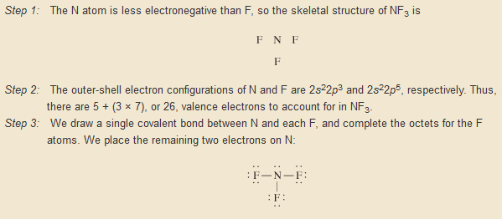
From Page 352
Lewis Dot Structures
Organize the atoms (usually lowest EN in the middle)
Count total electrons
Draw a 2 e⁻ bond between the atoms
Add electrons/bonds until you use up the total e⁻ and you reach an octet.

Slide 19
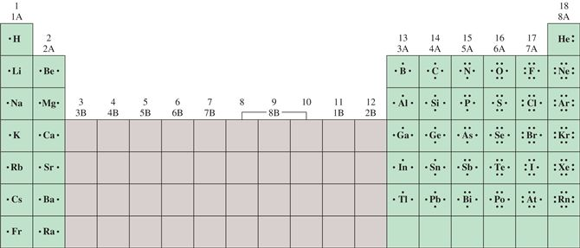
Alternative Strategy
NF₃
Combine unpaired electrons
Need 1 electron each
Needs 3 electrons

Slide 20
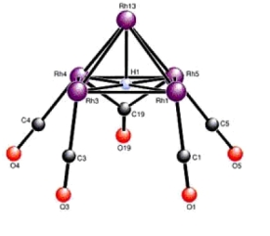
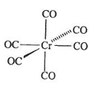
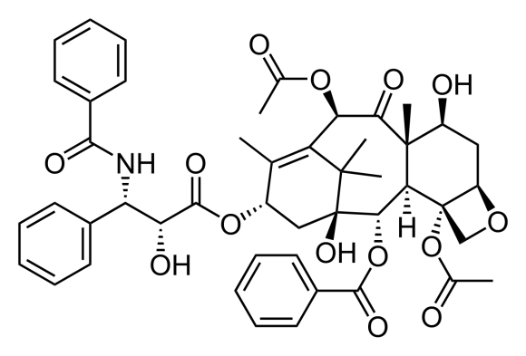
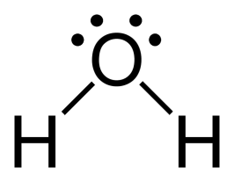

Shortcomings of Lewis Dot/Octet Rule
Violations of the “octet” rule.
Can get complex quickly.
???
C₄₇H₅₁NO₁₄
328 e⁻
Does not tell you the geometry (shape) of the molecule.
vs.

Slide 21
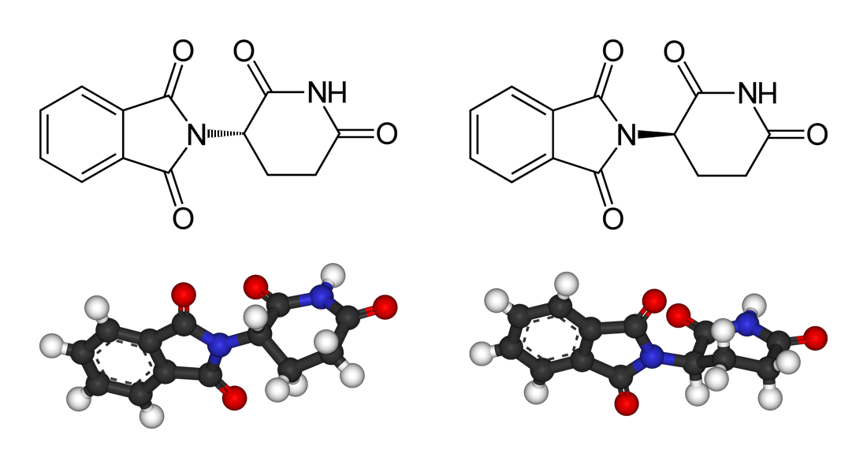
Shapes of Molecules
It is important to know how the atoms are arranged with respect to each other in 3-D space, i.e. molecular shape
Molecule’s shape affects its properties:
- melting and boiling points
- density of the compound
- chemical reactivity
- dipole moments
- chirality
Thalidomide

Slide 22
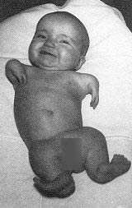
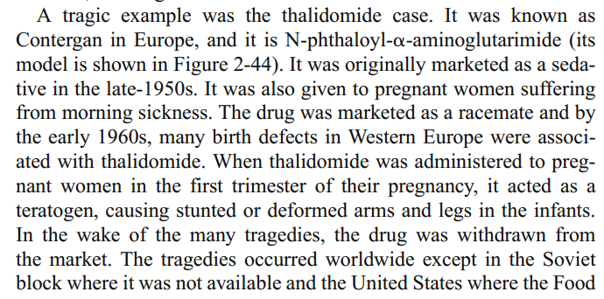
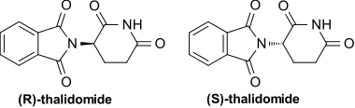
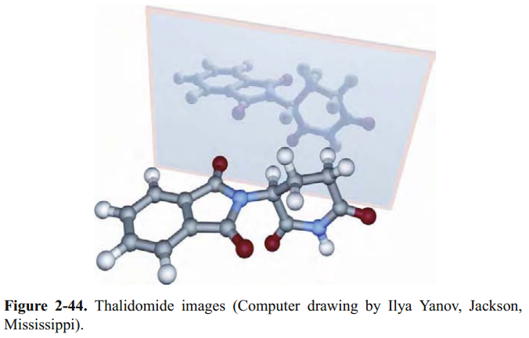
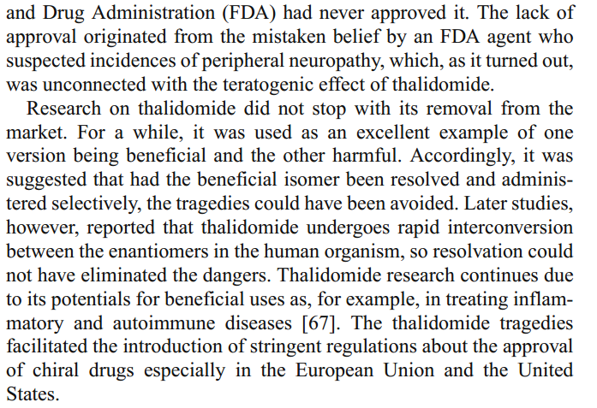

Shapes of Molecules

Slide 23

Shapes of Molecules
DNA is right handed
Amino acids are L
Carbohydrates are D
Alpha Helix is right handed
Origin/Evolution of life
Drug delivery/processing
Olfactory receptors
Shapes of molecules matter!

Slide 25
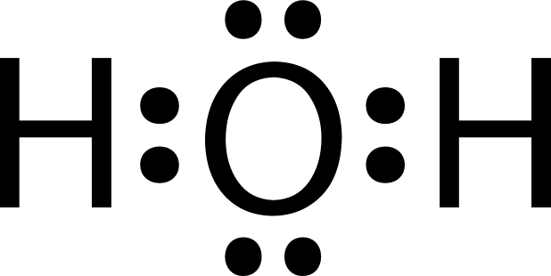
VSEPR Theory
Page 371
Valence-shell electron pair repulsion
Outermost electrons
bonds + lone pairs
repel each other

Slide 26
VSEPR Theory
In any molecule or ion, there are regions of high electron density:
  Bonds (shared electron pairs)
  Lone pairs (unshared electrons)
Due to electron-electron repulsion, these regions are arranged as far apart as possible
Such arrangement results in the minimum energy for the system

Slide 27
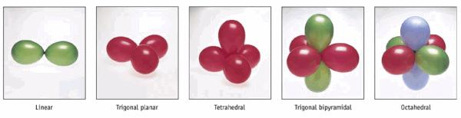
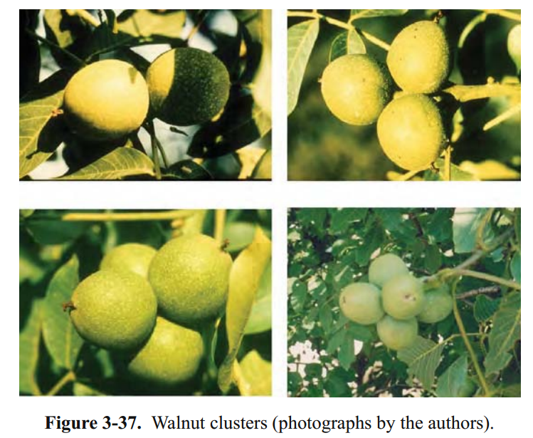
VSEPR Theory

Slide 28
Predicting Molecular Geometry
Draw Lewis structure for molecule.
Count number of lone pairs on the central atom and number of atoms bonded to the central atom.
Use VSEPR to predict the geometry of the molecule.

Slide 29


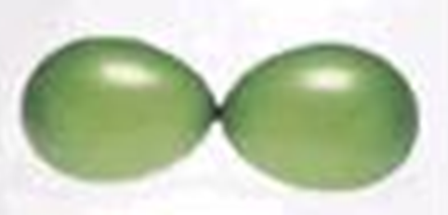
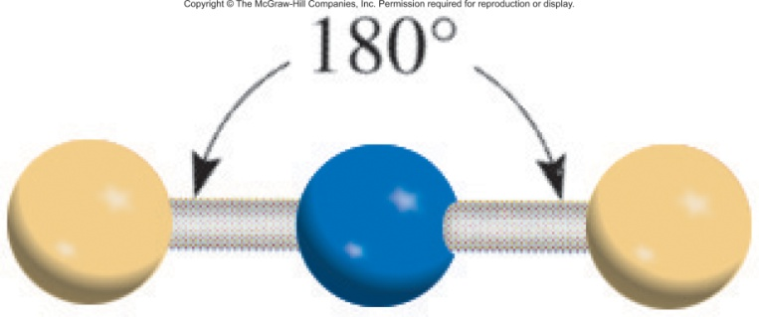
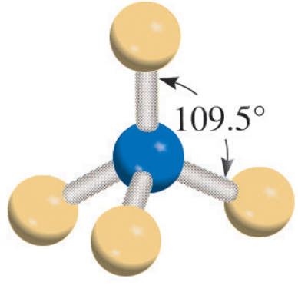
Examples
Beryllium Chloride (BeCl₂)
Methane (CH₄)
2 e⁻ balloons
4 e⁻ balloons

Slide 30
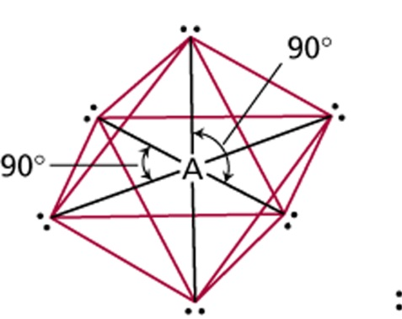
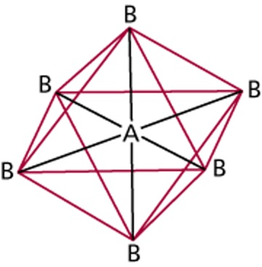
VSEPR Theory
# of atoms
bonded to central atom
Arrangement of electron pairs
Molecular
Geometry
Class
AB₂
2
linear
linear
trigonal planar
trigonal planar
AB₃
3
AB₄
4
tetrahedral
tetrahedral
trigonal
bipyramidal
trigonal
bipyramidal
AB₅
5
AB₆
6
octahedral
octahedral

Slide 31
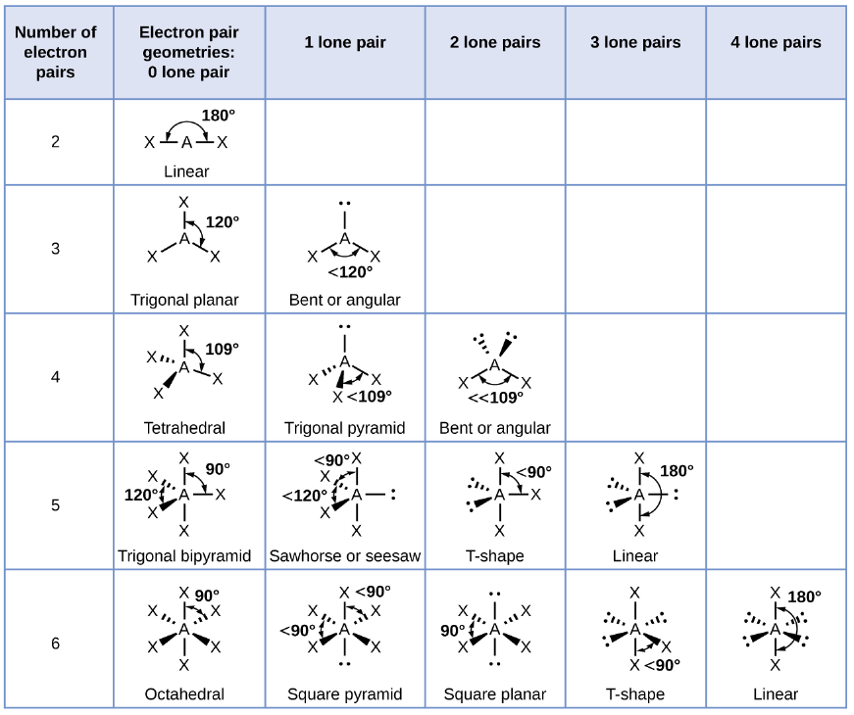
VSEPR Theory
X = atom
= lone pair
linear
trigonal planar
tetrahedral
trigonal
bipyramidal
octahedral

Slide 32
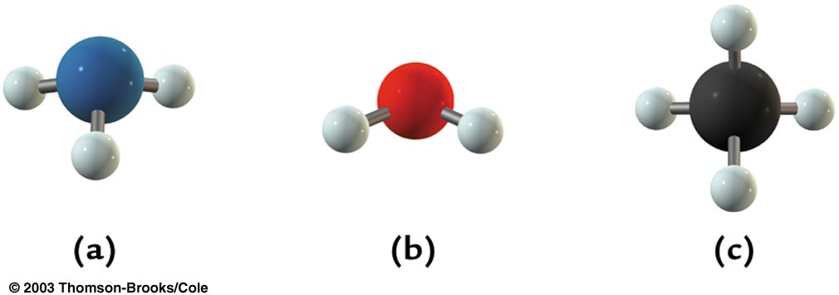
Electronic vs Molecular Geometry
Electronic geometry
  Distribution of regions of high electron density around the central atom
Molecular geometry
  Arrangement of atoms around the central atom
Electronic
Geometry
NH₃
H₂O
CH₄
Tetrahedral
Molecular Geometry =
Triagonal Pyrimidal
bent
tetrahedral

Slide 33
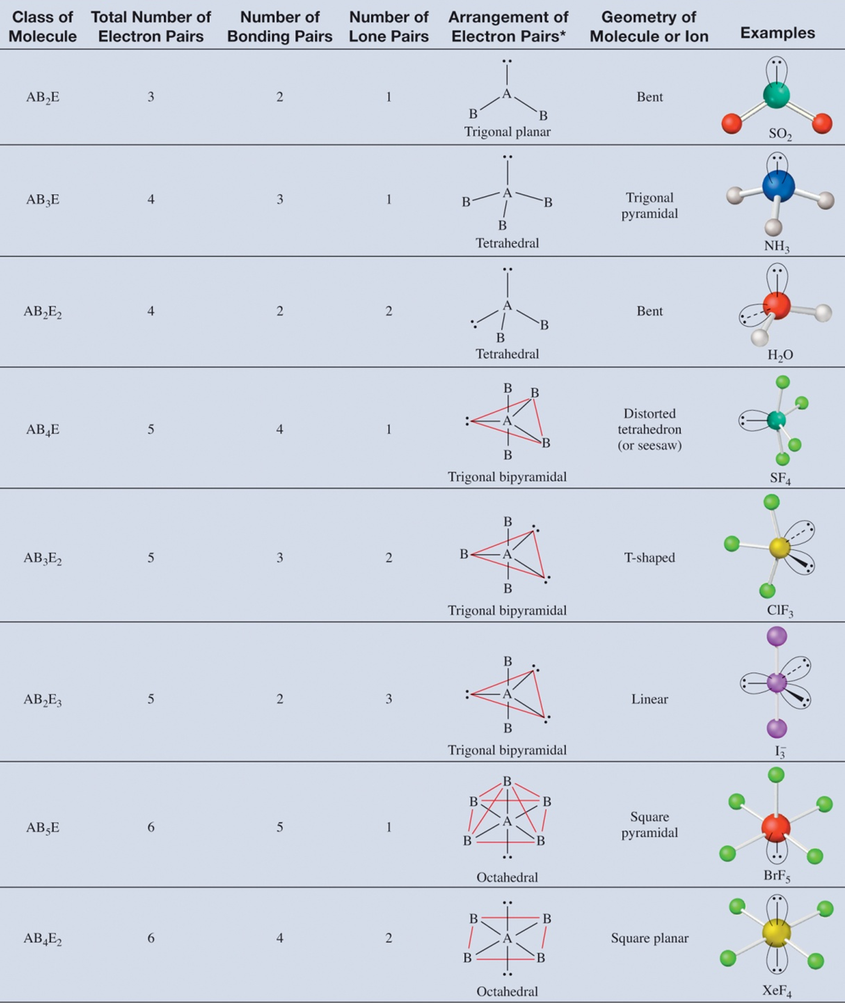
Electronic Geometry
B = atom
= lone pair
trigonal planar
tetrahedral
tetrahedral
trigonal
bipyramidal
trigonal
bipyramidal
trigonal
bipyramidal
octahedral
octahedral

Slide 34
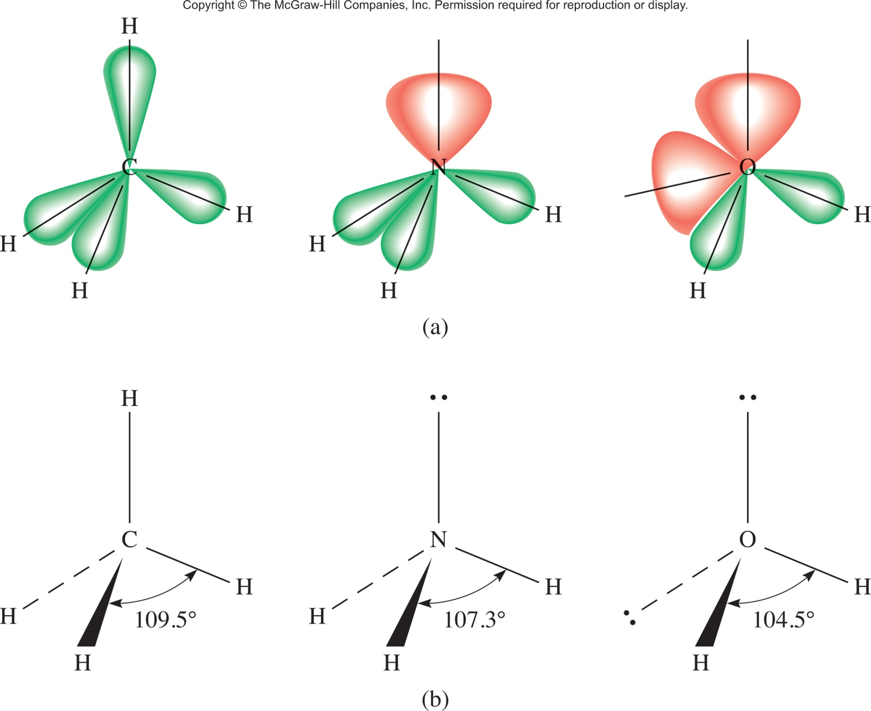
Predicting bond angles
  A lone pair takes up more space than a bond

Slide 35
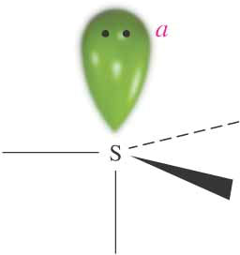
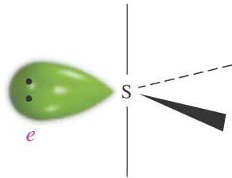
Geometry of SF₄
  A lone pair takes up more space than a bond
SF₄ Electronic geometry: 5 e⁻ balloons = triaganol bipyrimidal
Which of these is the correct molecular geometry?
F
F
F
F
or
F
F
F
F
A
B
3 bonds at 90°
1 bond at 180°
2 bonds at 90°
2 bonds at 120°

Slide 36
Five Basic Molecular Structures
Linear
Trigonal
Tetrahedral
Trigonal bipyramidal
Octahedral
Reality
vs
Plato
Tetrahedron
Hexahedron
Octahedron
Dodecahedron
Icosahedron

Slide 37
Summary
Plato was right and wrong.
Atoms combine to create bonds (ionic, covalent).
  Ionic (electrostatic)
  Covalent (shared electrons)
Lewis dots predict bonding (most of the time).
VSEPR Theory helps predict structure.
  Balloon prediction is right.
  Electron pairs repel more than bonding electrons.

Slide 38
A major reason why structure matters!

Slide 39


Dipole Moment
Dipole moment (μ)
  The product of the charge Q and the distance r between the charges Q+ and Q–
μ = Q × r
Measured in debyes (D)
1 D = 3.336×10^{–30} C m
Polar Covalent Bonds
  Bonds between elements with different electronegativity have an asymmetric electron density distribution

Slide 40
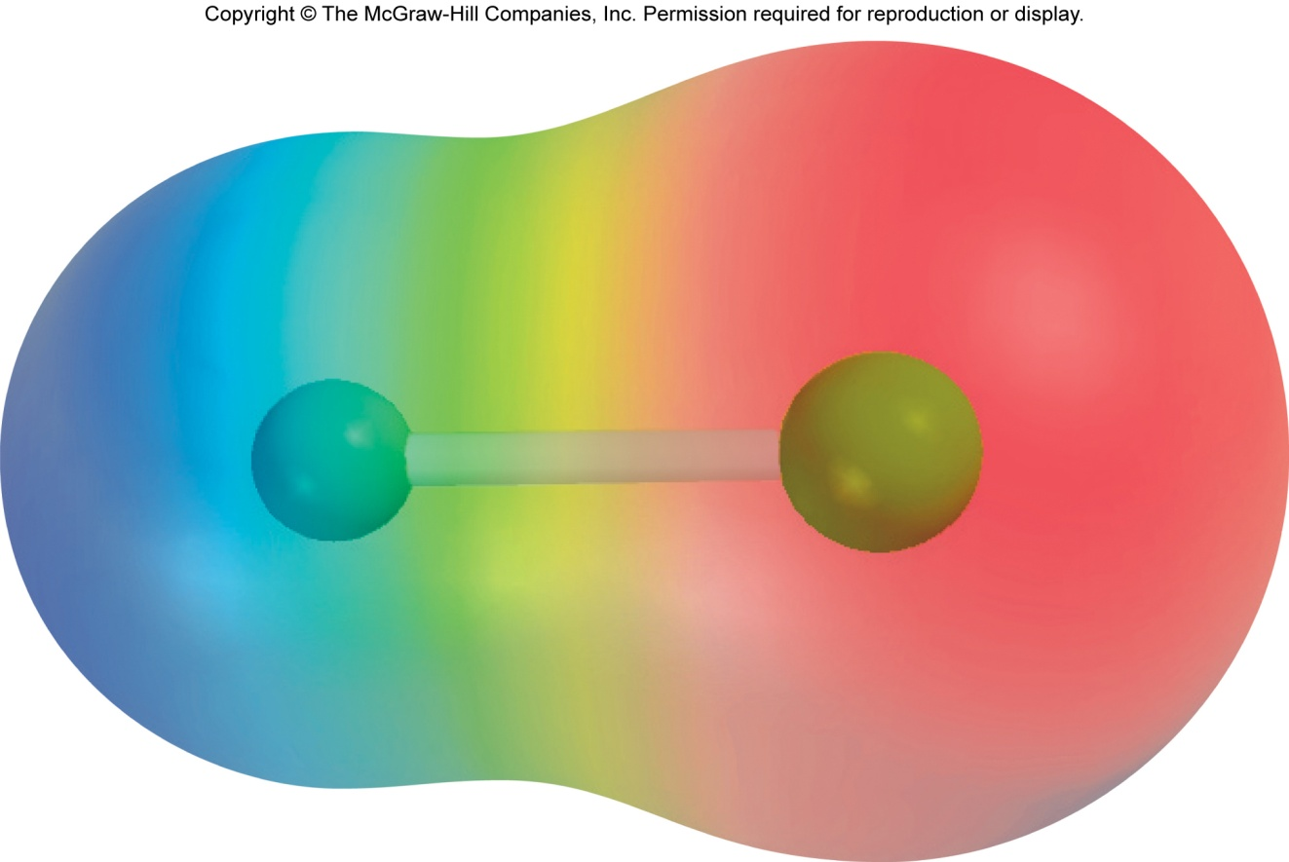
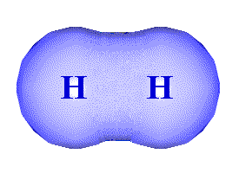
Dipole Moments and Polar Molecules
Even distribution of electron density
electron poor
region
electron rich
region
H
F
δ+
δ−
non-polar molecule
polar molecule

Slide 41


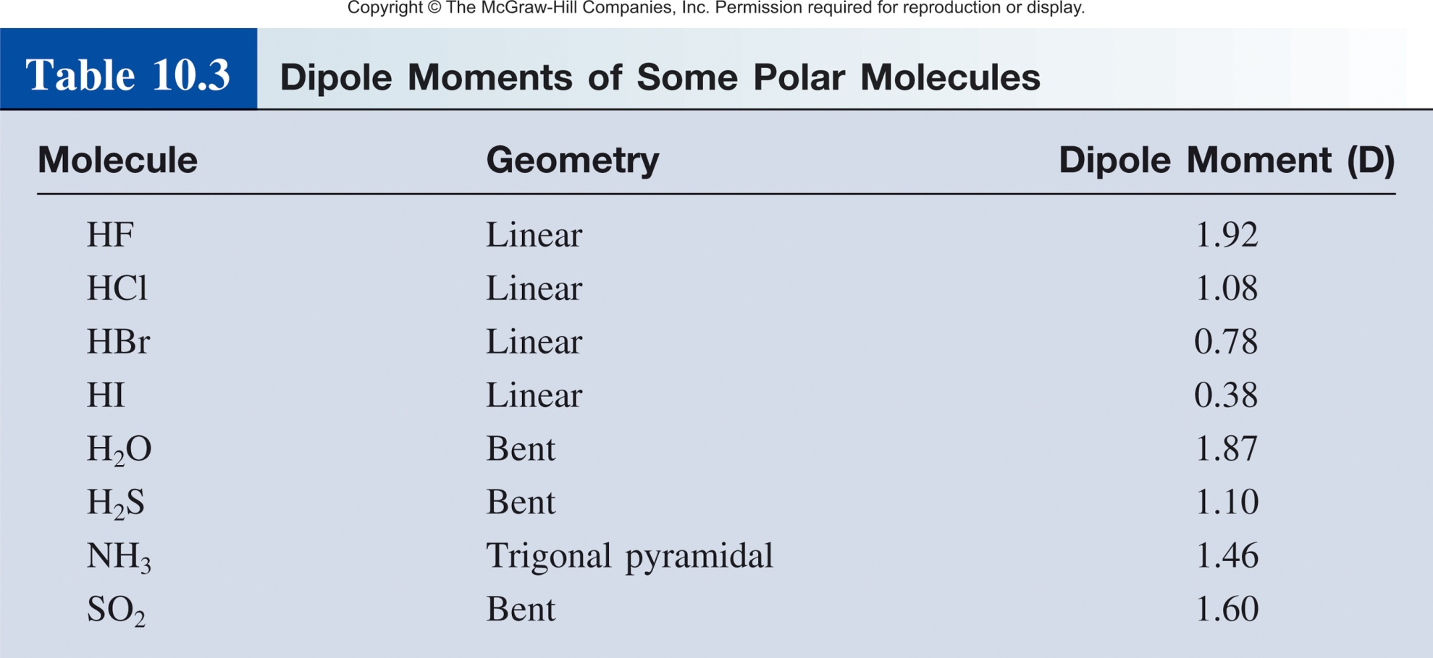
Examples of Dipole Moments
μ = Q × r
Measured in debyes (D)
1 D = 3.336×10^{–30} C m
r

Slide 42
Polar and Nonpolar Molecules
Nonpolar Molecule
  Dipole moments for all bonds cancel out
Polar Molecule
  Dipole moments for all bonds don’t cancel out – the molecule has the resulting net dipole moment
Important to Note
  Even if a molecule contains polar bonds, it might be nonpolar, i.e. its total dipole moment = 0

Slide 43
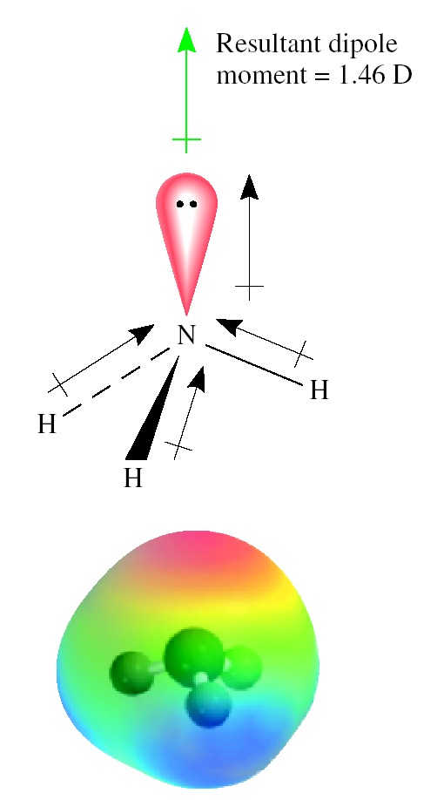
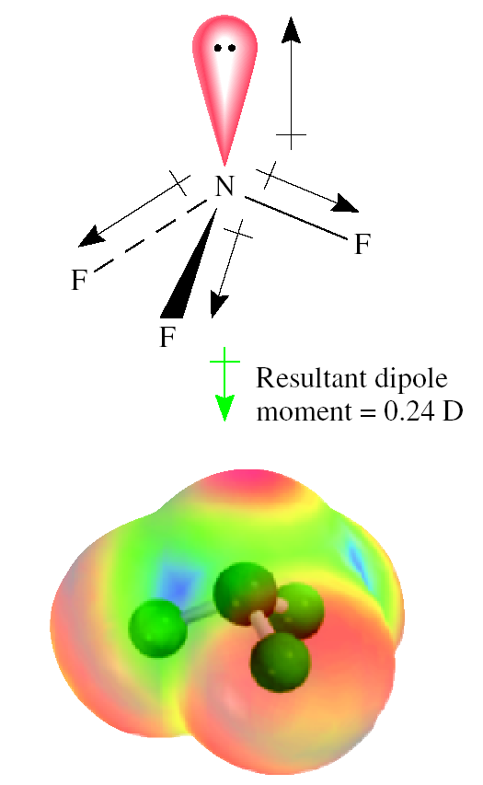
Dipole Moments of NH₃ and NF₃

Slide 44
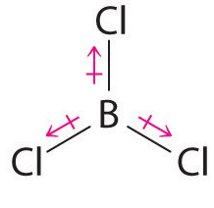





Polar and Nonpolar Molecules
Bond Dipole
Molecular Dipole
No molecular dipole = non-polar molecule

Slide 45






Question
A) polar
B) non-polar

Slide 46

Why should we care?
Solubility
Miscibility
Boiling/melting points
pK_{a}
Optical Transitions
Crystal Structure/Property
Thermal Electrical Conductivity
LCD screens

Slide 47
Summary
Bonds between different atoms have a dipole.
Bipole moment depends on distance and charge.
Bond dipoles sum to give molecular dipoles.
Molecules where dipoles cancel are non-polar.
Molecules where dipoles don’t cancel are polar.
Molecular Dipoles dictate molecular properties.

Slide 48


I am not going to test you one this. But it is good to know.

Slide 49
Beyond Lewis Dots
Chemical bonds- Attractive forces that hold atoms together in compounds are called chemical bonds.
  Covalent bonds – resulting from sharing of one or more electron pairs between two atoms
Not an accurate depiction of a chemical bond!
Electrons don’t just occupy one atom or a point in space.
For a better description we turn to molecular orbital theory.

Slide 50
Molecular Orbital Theory
The main postulates:
  Electrons have wave like properties that define their orbital.
  Interaction of the atomic orbitals (AOs) leads to the formation of molecular orbitals (MOs) associated with the entire molecule
  The total number of MOs formed equals to the total number of AOs involved in their formation
  The AOs combine in-phase (constructively) and out-of-phase (destructively), which leads to different energies of the resultant MOs

Slide 51




Molecular Orbital Theory
Electrons around an atom can be described as waves.
Waves can interact-
constructively
destructively
bonding interaction
anti-bonding interaction
Hydrogen-
1s orbital
1s wavefunction

Slide 52

MO Energy Level Diagram
  In-phase – bonding MO – σ_{1s}
  Out-of-phase – antibonding MO – σ∗_{1s}

Slide 53

Moving on to p-Orbitals
Hydrogen-
1s orbital
1s wavefunction
Larger Atoms (Li,B,C,N,O)-
p orbital
p wavefunction

Slide 54






Interaction of p-Orbitals

Slide 55




Diatomic MO Diagram

Slide 56

Diatomic MO Diagram
MO theory predicts why oxygen is magnetic.

Slide 57



Magnetic Oxygen
2 unpaired e⁻magnetic
0 unpaired e⁻not magnetic

Slide 58

MOs of Ferrocene FeC₁₀H₁₀

Slide 59



Why do we care about MOs?
Magnetic Properties
Oxidation/Reduction Potentials
Catalytic Activity
Stereoselectivity
Enzyme Binding

Slide 60
Summary
Electrons behave like waves.
Wave interact:
  constructively (bonding)
  destructively (anti-bonding)
Atomic orbitals combined to give moelcule orbitals.
Can model very complex molecules with simple s and p orbital interactions.
Predict properties with molecular orbitals.

Slide 61
End of Chapter 7 and 8 review!

